Slide 1
Day 1
Introduction to NoSQL
Introduction to MongoDB
MongoDB Installation
MongoDB CRUD
MongoDB Advanced CRUD
By Shalini Rathore

Slide 2
Introduction to NoSQL
Introduction to NoSQL
NoSQL, which stands for "Not Only SQL," is a type of database that provides a mechanism for storage and retrieval of data that is modeled in means other than the tabular relations used in relational databases.
Why NoSQL?
Scalability: NoSQL databases are designed to scale out by distributing data across many servers.
Flexibility: They can handle a variety of data types, including structured, semi-structured, and unstructured data.
Performance: NoSQL databases are optimized for specific data models and access patterns, which can lead to better performance for certain types of applications.
Schema-less: NoSQL databases often allow for dynamic schemas, which can be beneficial for applications that evolve rapidly.

Slide 3
Relational v/s NoSQL stores
Relational Databases (SQL):
Use structured query language (SQL) for defining and manipulating data.
Data is stored in tables with rows and columns.
Suitable for complex queries and transactions.
Examples: MySQL, PostgreSQL, Oracle.
NoSQL Databases:
Do not use SQL for data manipulation.
Data can be stored in various formats: key-value, document, column-family, graph.
Suitable for hierarchical

Slide 4
Entities, Relationships, and Database Modelling
Entities: Objects or concepts that can have data stored about them.
Relationships: Associations between entities.
Database Modelling: The process of structuring a database, which involves defining tables (in SQL) or collections (in NoSQL), and the relationships between them.

Slide 5
When to use Relational/NoSQL?
Use Relational Databases when:
You need ACID transactions (Atomicity, Consistency, Isolation, Durability).
Your data is structured and fits well into tables.
You require complex queries and joins.
Use NoSQL Databases when:
You need to handle large volumes of data with varying structures.
Your application requires high scalability and performance.
You are dealing with real-time data and big data applications.

Slide 6
Categories of NoSQL stores
Key-Value Stores: Store data as a collection of key-value pairs.
Examples: Redis, DynamoDB.
Document Stores: Store data in document-like structures (e.g., JSON, XML).
Examples: MongoDB, Couchbase.
Column-Family Stores: Store data in columns rather than rows.
Examples: Cassandra, HBase.
Graph Databases: Store data in graph structures with nodes, edges, and properties.
Examples: Neo4j, Amazon Neptune.

Slide 7
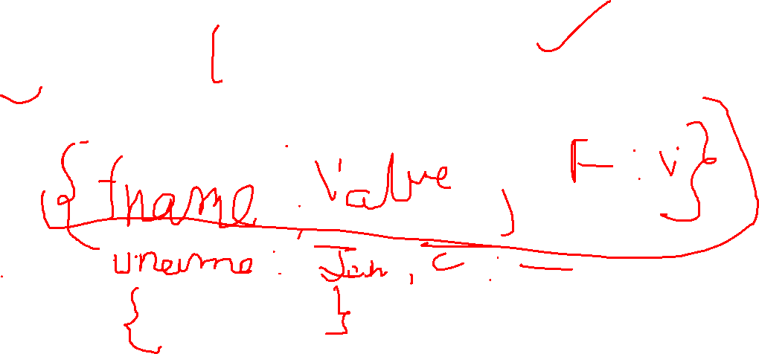
Introduction to MongoDB
MongoDB is a popular NoSQL database that provides high performance, high availability, and easy scalability. It is classified as a document-oriented database , meaning it stores data in flexible, JSON-like documents instead of rigid tables

Slide 8

Key Features of MongoDB
1. Document-Oriented Storage :
- Data is stored in BSON (Binary JSON) format, which is a binary representation of JSON-like documents.
- Documents can have nested structures, making it easy to represent complex data relationships.
2. Schema Flexibility :
- MongoDB is schema-less , meaning each document in a collection can have a different structure.
- This allows for rapid iteration and adaptation to changing application requirements.

Slide 9
Key Features of MongoDB
3. Scalability :
- MongoDB supports horizontal scaling through sharding , which distributes data across multiple servers.
- It can handle large datasets and high traffic loads efficiently.
4. High Performance :
- MongoDB uses indexing to speed up queries.
- It supports in-memory storage for faster data access.

Slide 10
Key Features of MongoDB
5. Rich Query Language :
- MongoDB provides a powerful query language that supports CRUD operations (Create, Read, Update, Delete), aggregation, and text search.
6. Replication and High Availability :
- MongoDB uses replica sets to ensure data redundancy and fault tolerance.
- If the primary server fails, a secondary server can take over automatically.
7. Aggregation Framework :
- MongoDB includes a powerful aggregation framework for performing complex data transformations and analysis.

Slide 11
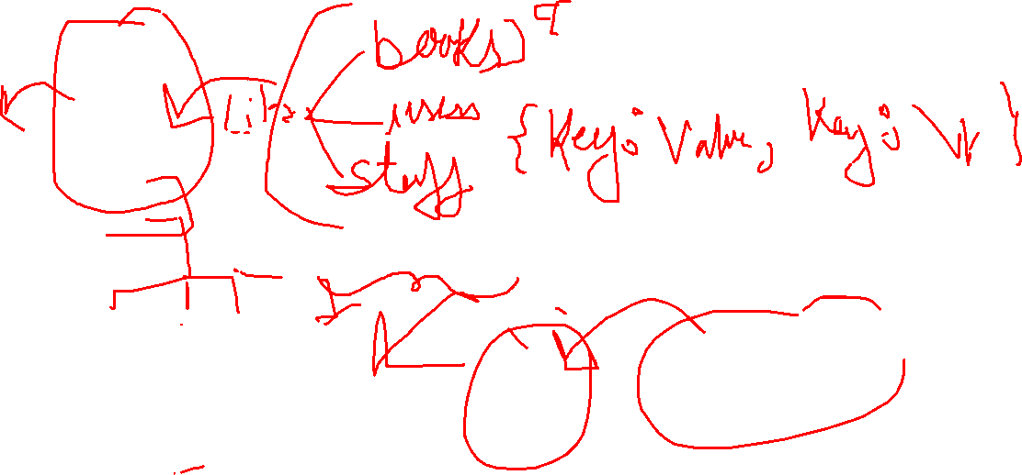
Core Concepts in MongoDB
1. Database :
- A container for collections. A single MongoDB server can host multiple databases.
2. Collection :
- A group of MongoDB documents. Collections are analogous to tables in relational databases but do not enforce a schema.
3. Document :
- A set of key-value pairs stored in BSON format. Documents are analogous to rows in relational databases but are more flexible.

Slide 12
Core Concepts in MongoDB
4. Field :
- A key-value pair within a document. Fields are similar to columns in relational databases.
5. Index :
- A data structure that improves the speed of data retrieval operations.
6. Sharding :
- A method for distributing data across multiple servers to handle large datasets and high throughput.
7. Replica Set :
- A group of MongoDB servers that maintain the same data set, providing redundancy and high availability.

Slide 13
Core components
Mongo db server----- mongod(data requests , data access managed , background managements)
mongos: MongoDB sharding Router, works as query router for shared
Storage engine
Data Model

